Slide 1
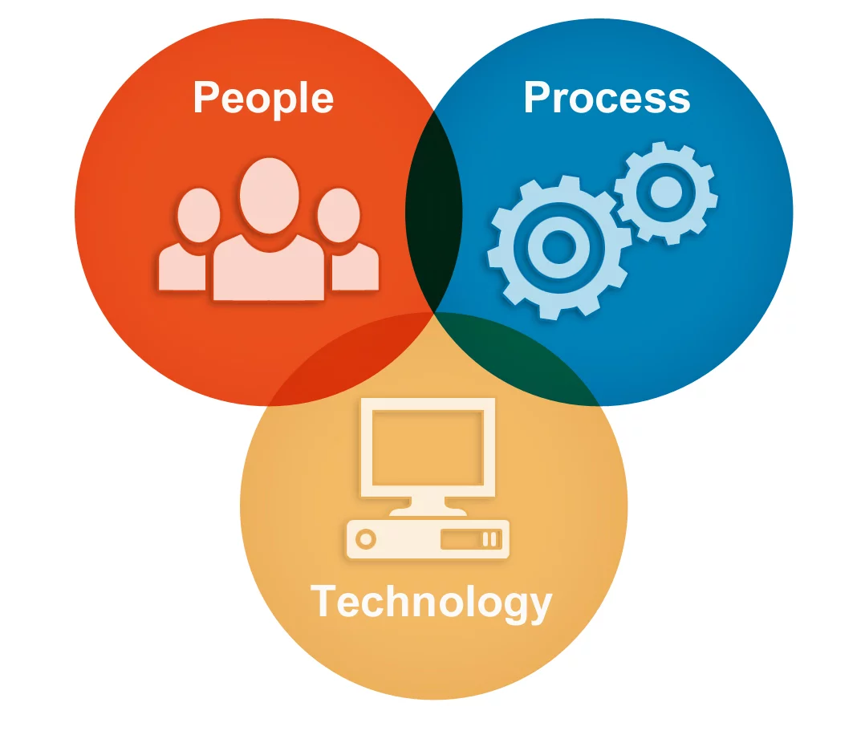
Detailed Operational Design
Scope of this presentation is to present a work example for detailed operational design elaborating people, process & technology driving business towards target operating model:
Existing business processes and systems (As-Is),
Business Processes and systems to build (To-Be),
Business Process descriptions,
Service Level Agreements (SLA's), and
Roles and responsibilities.

